Slide 1
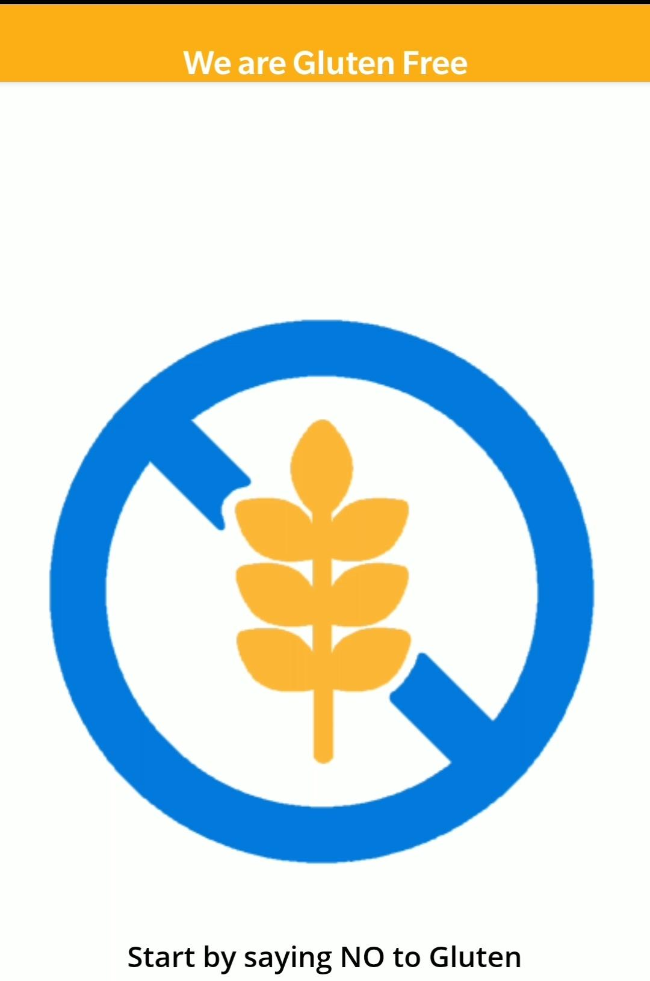


Erasmus+ Knowledge to Assist in Coeliac Behavioural Change
Researcher: Dion Buckley
This project was funded by Erasmus+
Introduction
Methods
Results
Conclusions
This project was chosen for two reasons. Firstly due to it being at the forefront of study into the effectiveness of gamification techniques on long term behaviour change. Viewed here through measuring engagement on a health app and relating that to behaviour change eventually leading to dietary compliance. Secondly; the potential positive impact these findings could have on the lives of struggling coeliac patients.
For the qualitative study we planned to deliver questionnaire before and after the 21 day test. All in effort to isolate one metric - the effect of gamification on engagement.
To achieve this we will have a coeliac control group testing a quiz with no gamified elements. Then there will be a group to test the gamified quiz. Both groups are to be tested both before and after the quiz using the qualitative method described above. This will be the most sure way to; Measure the effect which gamification holds over engagement.
N.B: Unfortunately due to the Covid-19 pandemic the planned 21 day challenge was unable to go ahead as planned on March 1st or any other date thereafter during the remaining academic calendar. However I was suggested by my supervisor to state that the original study as shown here was in fact outlined with a clear plan and goal in sight and should be considered as an extreme circumstance meaning another high level study could not be produced within the new timeframe.
The benefits of gamification have now become clear to me. For example the higher likelihood of user engagement and therefore compliance in important matters such as Coeliac diet. Also I have seen the pitfalls of overusing gamified techniques without suitable use case; i.e oversaturation of an app. If I could start over I would prepare backup study for extreme cases, as we find ourselves in today.
Bibliography
Cugelman, Brian. 2013. “Gamification: What It Is and Why It Matters to Digital Health Behavior Change Developers.” JMIR Serious Games 1 (1). https://doi.org/10.2196/games.3139.

